Slide 1

Mini Project
Btech.||V Semester||2021-2022
Submitted to – Mr. Mandeep Singh
By :-
Surya Raj (191500832)
Priya Tomar (191500603)

Slide 2
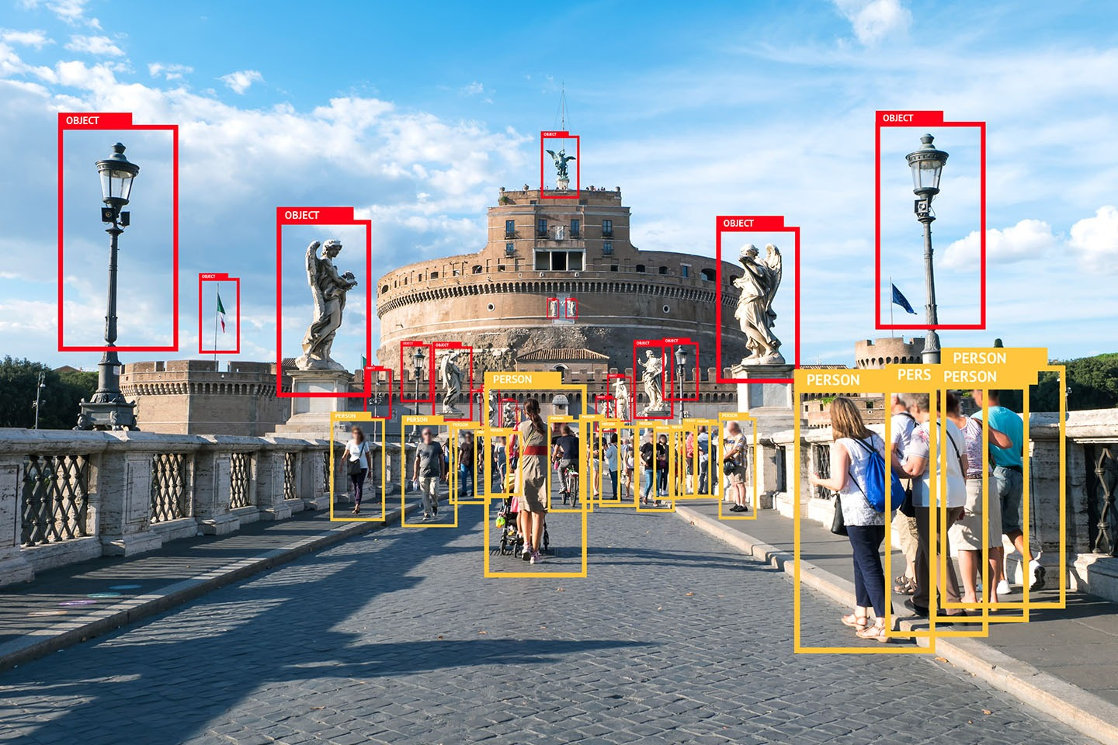
Object Detection
We have made this project of Object Detection for the course of Btech. , V sem, to fulfill the requirements of Mini Project! This project has been very challenging and interesting to do.
Thanks to our Mentor for the guidance along the way.

Slide 3
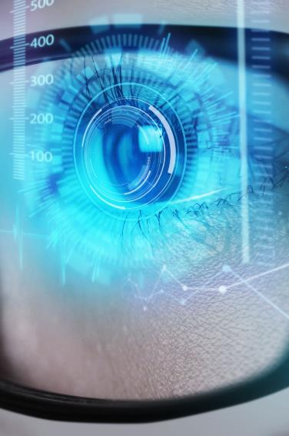
Problem Statement
The Situation
Need
Financials
The Machines are getting smarter every day but they are still Machines. They cannot just think, see or act like Humans with their own intuition.
We need a technology that can make a machine think and decide it’s next course of action based on thoughts as if it was a human to achieve better results and automation.
The global machine learning market is projected to grow from $15.50 billion in 2021 to $152.24 billion in 2028 at a CAGR of 38.6% in forecast period.
Costs
Usability
This project accounts to AWS Rekognition service and takes cost as per AWS service fees.
We want something that is User-Friendly , smart and can adapt to different humanly situations. Our Project can have multiple usability in such ways.

Slide 4
Solution
Close the gap
Target audience
Our API makes it easier to be integrated in any development environment and analyze any image. One can even use our webapp for instant analysis!
Anyone can use this simple WebApp as the interface is very user friendly.
Cost savings
Easy to use
Reduce costs for client by helping him as there is 0 development fees , and he can just play with images as he pleases
Simple drop down menu to select service and select image , click on Play button and the magic happens with a single click!

Slide 5




Project Overview
Unique
Deployment
Tested
Authentic
Only project specifically dedicated to Object Detection , Celebrity Detection and Facial Analysis.
Beautiful and Classically designed project that's both simple and functional.
It currently suns on local server but can be deployed to cloud with a domain and be accessed by anyone.
Conducted many tests on different kind of images and found that precision could be better but it depends on quality of image and AWS service.
Designed with the help and input of our mentor with the best tools available such as DJANGO, AWS and PyCharm.

Slide 6
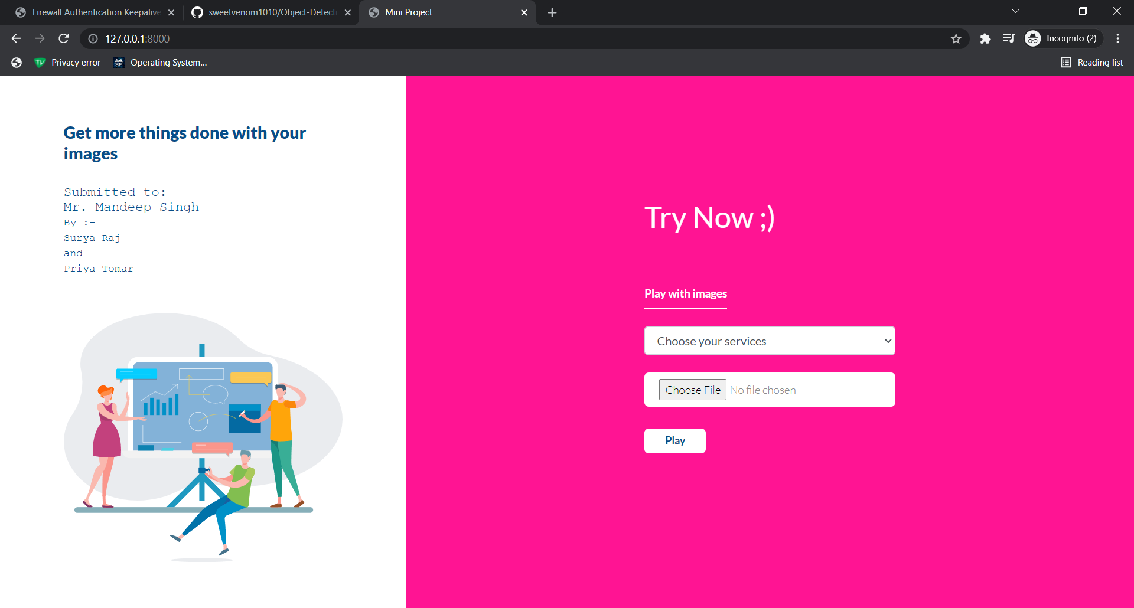
The UI
Simple and efficient to use​
Quick to load the WebApp
Can be used infinite times without reloading page​​

Slide 7
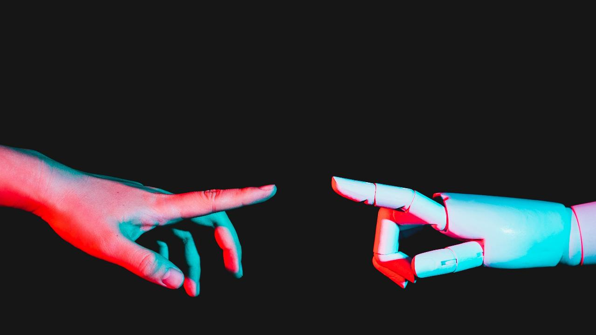
Functioning Demo

Slide 8
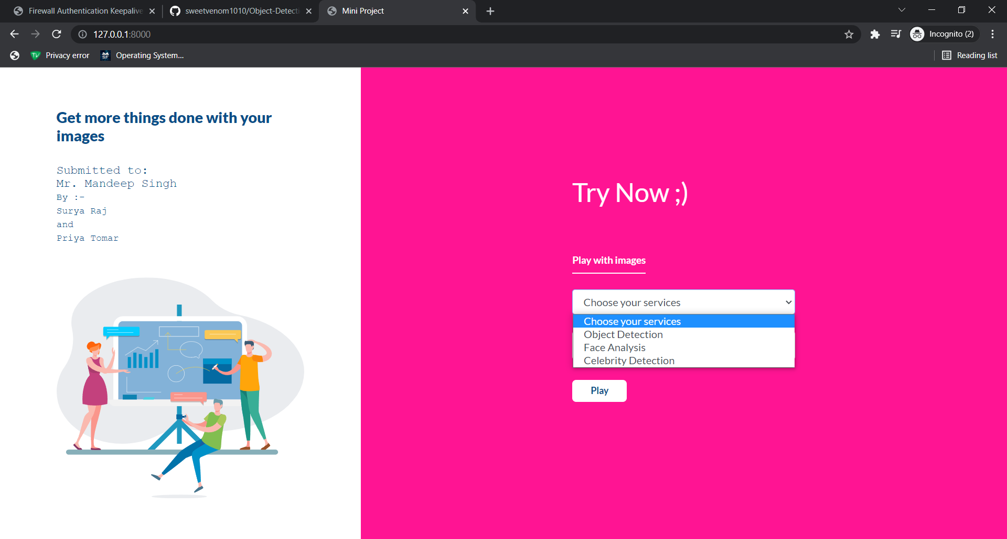
Playing with Images
Step 1. Choose a Service
We have chosen Object Detection service here.

Slide 9
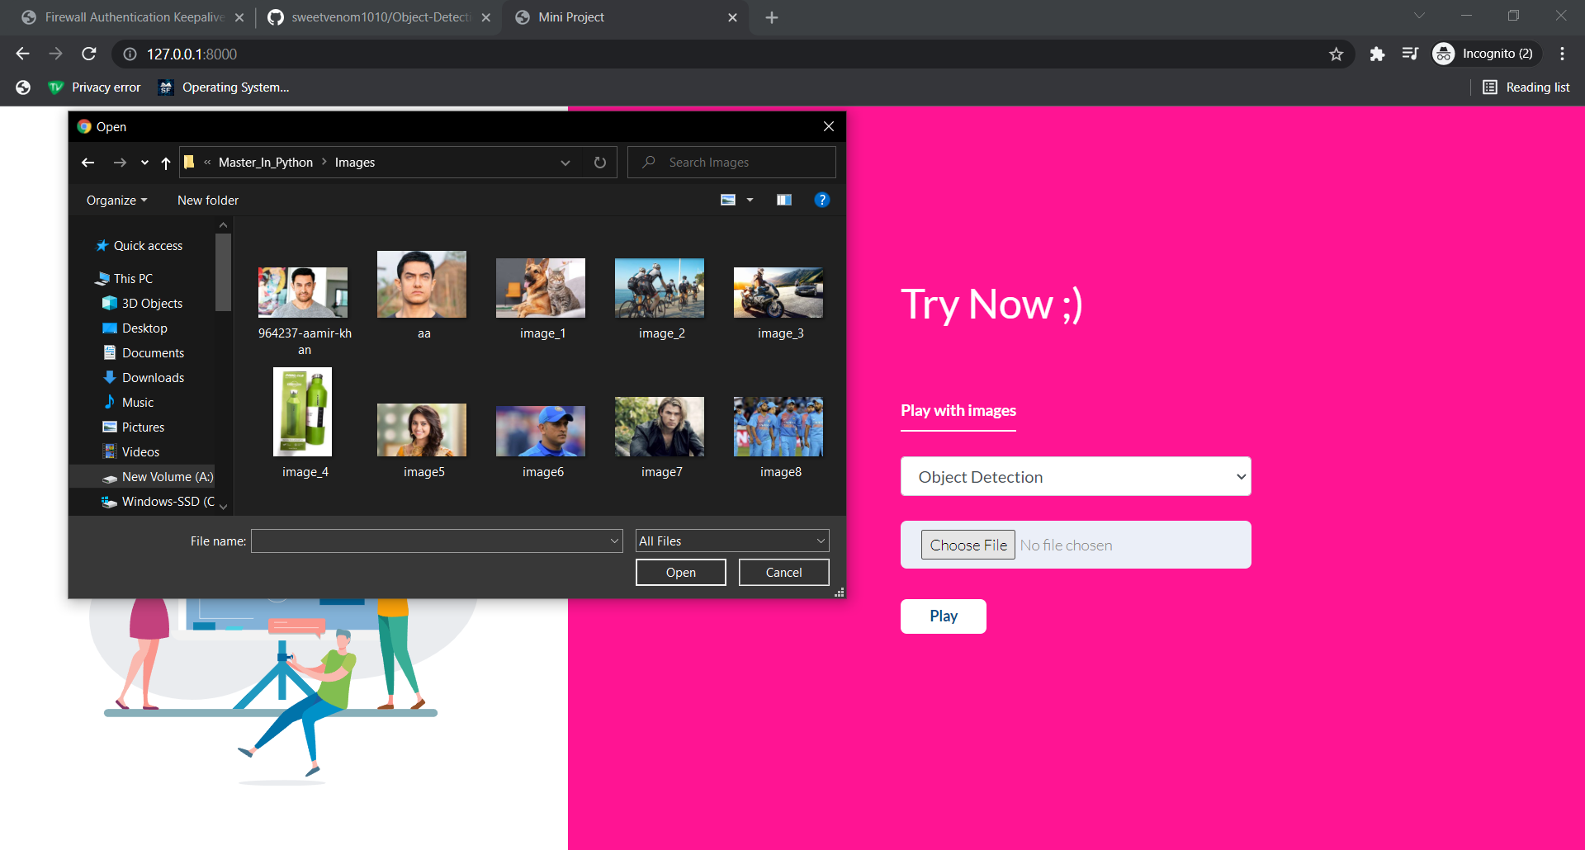
Playing with Images
Step 2. Choose an Image
We have chosen a random image with multiple objects here.

Slide 10
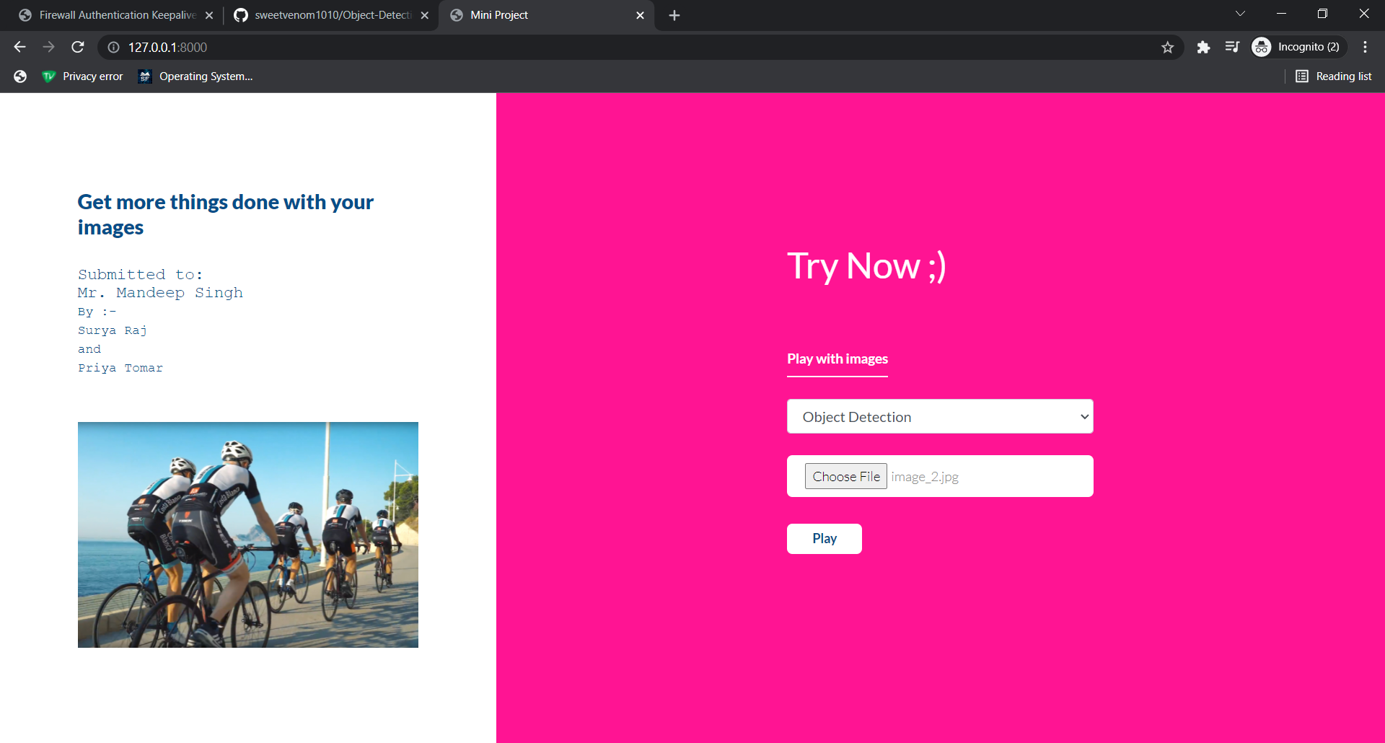
Playing with Images
Step 2.1 Selected Image
As soon as we select an image , it gets replaced by the graphical image in webpage (on left side) .

Slide 11

Playing with Images
Step 3. Click on play
When we click on play button , the image gets processed on the backend and gets replaced with the result having multiple objects being present with their names and a bounding box.

Slide 12
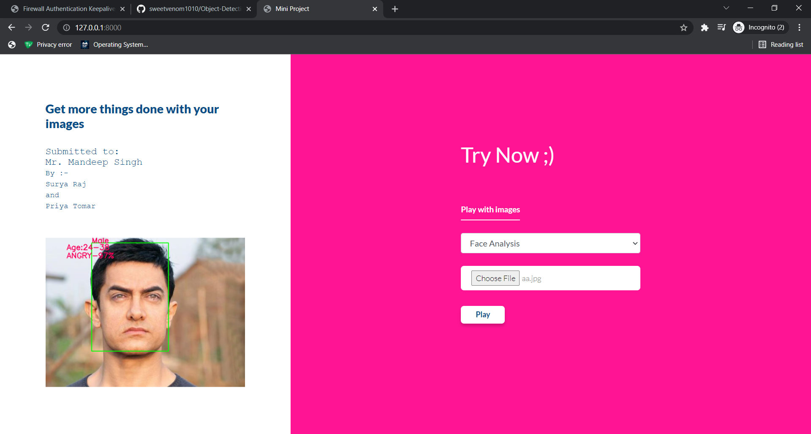
Playing with Images
Face analysis
The Machine detects 3 features from the facial aspects, having:-
Gender
Age Range
Current Mood
It can have more results and applications as per use case.

Slide 13
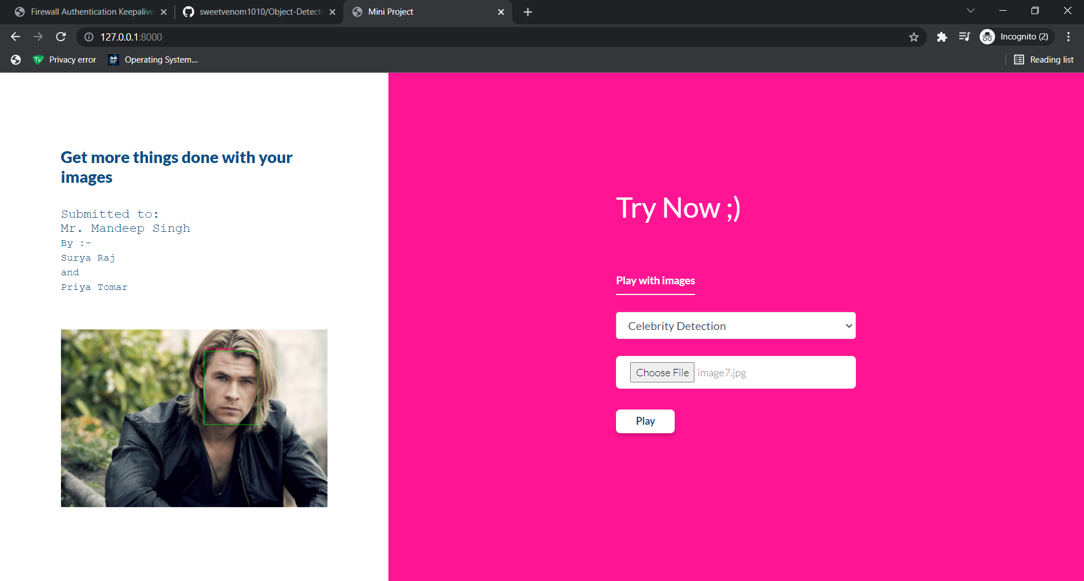
Playing with Images
Celebrity Detection
The Machine tells us about the name of the person , if he is a popular person or a known Celebrity.
It does not result anything if it cannot detect it.

Slide 14

How does it work
Object Detection
AWS Rekognition provides a service called as Detect Labels , which has a pre-trained model for detecting all objects in an image
Face Analysis
AWS Rekognition provides a service called as Detect Faces , which has a pre-trained model for detecting all features in a face.
Celebrity Detection
AWS Rekognition provides a service called as Recognize Celebrities , which has a pre-trained model for detecting all the popular people.

Slide 15
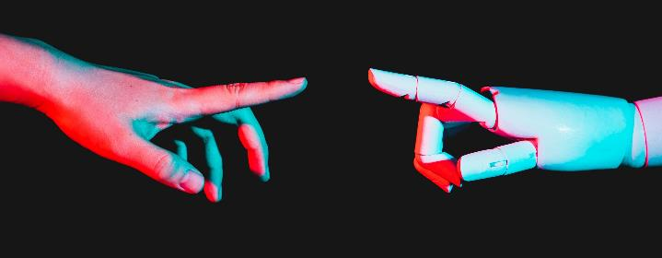
The vision
Abstract
Application
All the companies in future are going to be data driven Technology Companies. Humans can easily detect and identify objects present in an image. The human visual system is fast and accurate and can perform complex tasks like identifying multiple objects and detect obstacles with little conscious thought. With the availability of large amounts of data, faster GPUs, and better algorithms, we can now easily train computers to detect and classify multiple objects within an image with high accuracy.
The applications of this technology are immense as it provides a better decision making process to a machine.
If the machine can collect data and based on it’s human-like judgement , it can predict future events and act accordingly in view of them. Some of the things that can be revolutionized are :-
Product Reviews
Security
Disaster Prediction

Slide 16
Growth
Machine Learning in the future​
Quantum Computing
Automl
industries
Quantum computing is one advancement that has the potential to boost machine learning capabilities.
In 2019, Google’s quantum processor performed a task in 200 seconds that would take the world's best supercomputer 10,000 years to complete.
AutoML enables a wider audience to use machine learning, which indicates its potential to change the technology landscape. A data scientist can use AutoML to their benefit, for instance, to quickly find the algorithms they can use or whether any algorithms have been missed.
All industries are working on getting themselves equipped with ML technology so they can have better results. Some being :
Healthcare and pharma
Manufacturing
Automotive and Self Driving Vehicles

Slide 17
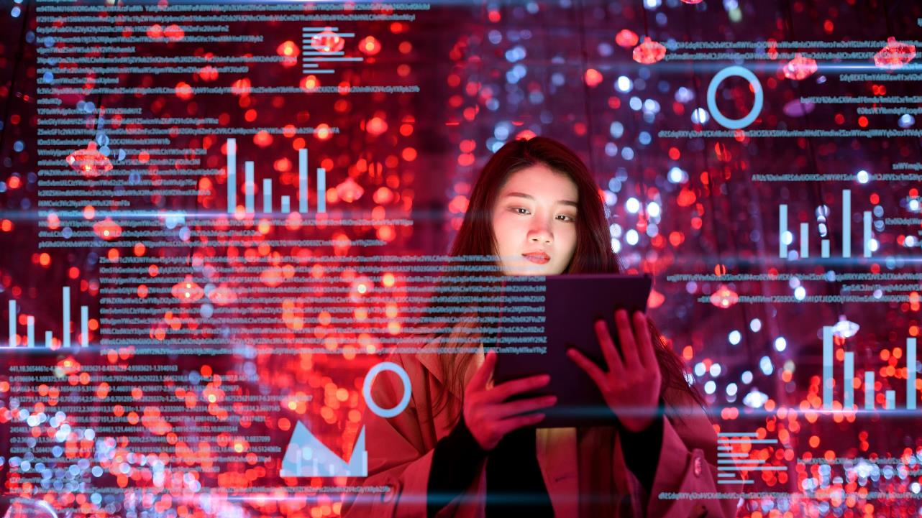
Summary
Many companies have already begun using machine learning algorithms due to their potential to make more accurate predictions and business decisions. In 2020, $3.1 billion in funding was raised for machine learning companies. Machine learning has the power to bring transformative changes across industries.
With machine learning being so prominent in our lives today, it’s hard to imagine a future without it.

Slide 18
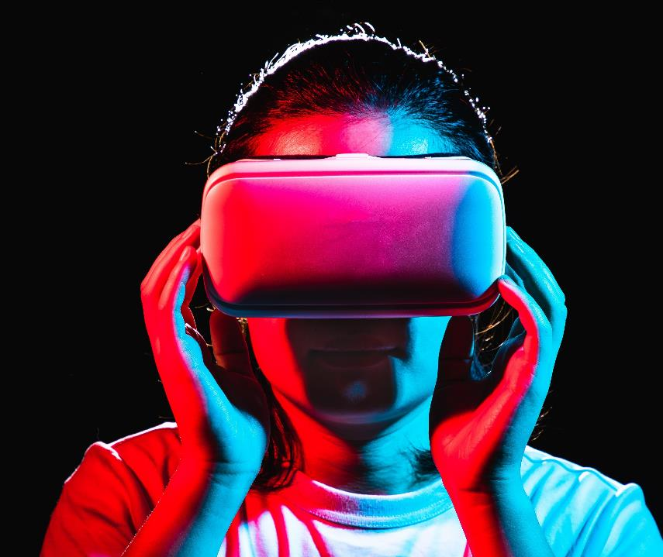
Thank you
Surya Raj Priya Tomar
191500832 191500603
Surya.raj_cs19@gla.ac.in Priya.tomar_cs19@gla.ac.in
GLA University

